Slide 1




Sneaky Squirrel Team
Karam DALI
Melchior BAUDOIN
Muhammed-Adeel KHAN
Julien NOIREAUX-FATTAZ
Zakaria LATRECHE​

Slide 2

Table of Content :
Previous Progress
Mechanical Design

Slide 3
Previous Progress
Initial Rules Discussions , Teams Management, Roles Distribution
Setup the GitHub fork, First 3D Concept, Discussion on the Strategies
Initialize the Components Discussion, Grabbing Mechanism, Technical Challenges, System Architecture
System Architecture and Algorithmic Flow, Electronic Components, Project Management

Slide 4
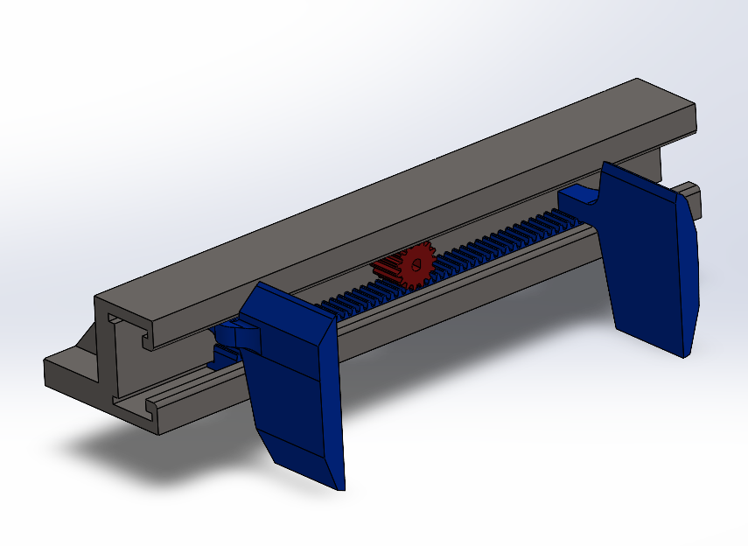
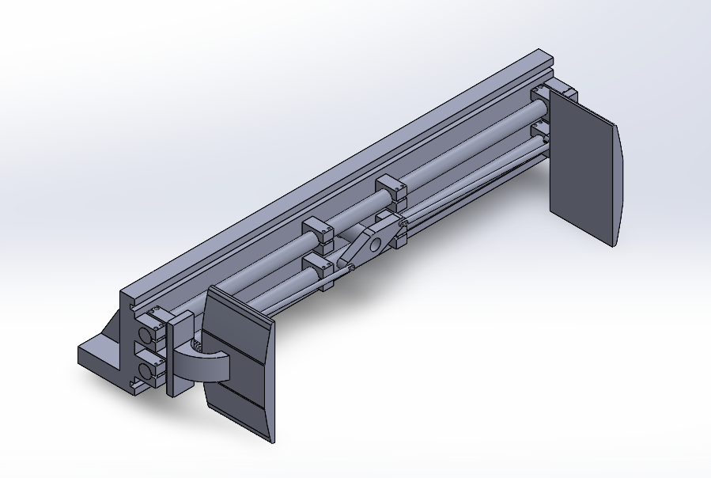
Mechanical Grabbing Mechanisms
Efficiency
Grabbing strength
Smooth operation
Easy to manufacture
Failure chances

Slide 5
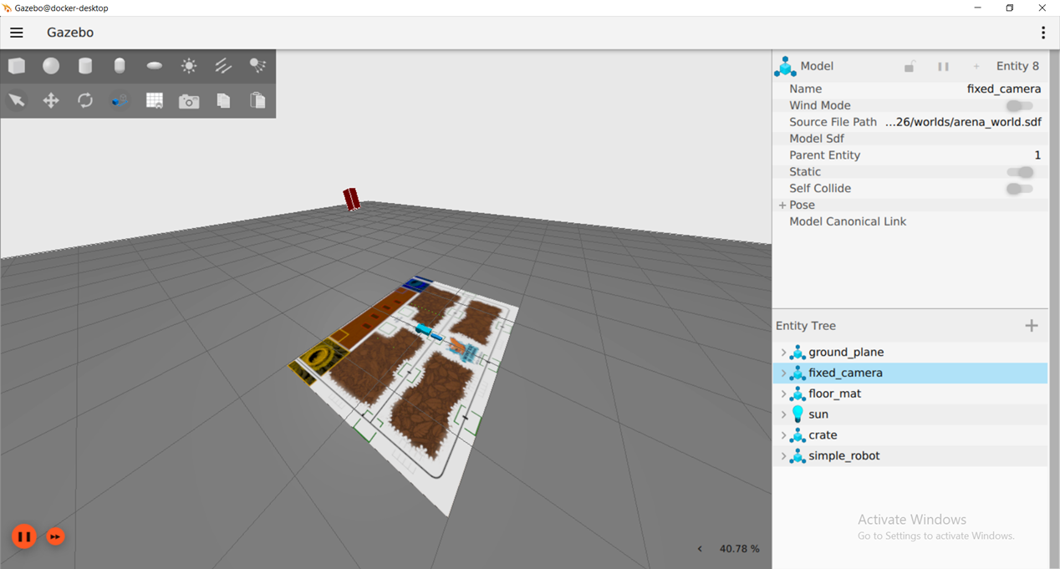
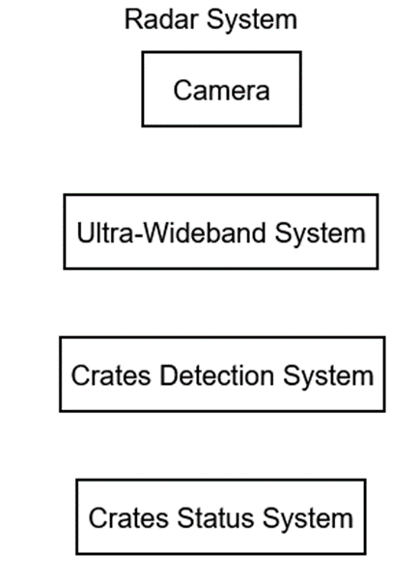



Radar System

Slide 6
Next Week Meeting Agenda

